Slide 1
HEMERA TRADING
Revolutionizing Crypto Trading with AI

Slide 2
CONTENTS
1
What is Hemera Trading?
2
Problem
3
Solution
4
Product
5
Market and Business Overview
6
HEM token
7
Tokenomics
8
Roadmap
9
Contact us

Slide 3
1
What is hemera trading?
Hemera Trading is an innovative crypto ecosystem that offers a comprehensive set of tools and services for cryptocurrency trading on Binance and Bybit exchanges (spot and futures).
With our advanced crypto bots, copy trading and AI tools we provide everything you need to succeed in the crypto world.
Hemera is like a Swiss Army knife of trading.

Slide 4
2
problem
Poor risk management
Lack of strategy
Emotional trading

Slide 5
AUTOMATED TRADING STRATEGIES
3
Solution
Pre-built and customizable bots allow traders to implement high-probability strategies effortlessly, ensuring consistent and profitable trading.
ADVANCED AI TOOLS
AI tools automate complex trading decisions, making it easier for traders to optimize their strategies and manage risks effectively.
RISK MANAGEMENT
AI-driven risk management tools help traders protect their investments by providing intelligent strategies and real-time monitoring.

Slide 6
4
PRODUCT
ADVANCED AI TOOLS FOR SMARTER TRADING DECISIONS.
SMART BOTS OFFER PRE-BUILT STRATEGIES FOR HIGH SUCCESS RATES.

Slide 7
4
PRODUCT
AI-powered bots designed for Hemera's advanced trading tactics.
Protect your investments with smart strategies.

Slide 8
4
product & ai tools practical uses
Provide token analysis based on volume profile, Fibonacci levels, and EMA lines for clearer trade insights, SL, and TP points.
HEMERA TA ANALYSIS
Execute trades directly from uploaded analysis images, allowing for quick and efficient trading decisions.
TRADE FROM IMAGE
CROSS-EXCHANGE
COPY TRADING
Register with API, set a monthly fee, and trade back to your original exchange. Allow others to follow your trades easily and quickly.
Create and customize your own trading bots tailored to your specific strategies and preferences. Bots can learn, adapt, and track the market to improve performance.
PERSONALIZED TRADING BOTS
Earn additional income through staking and farming opportunities available on the Hemera Trading platform with HEM token
STAKING & FARMING
REWARDS

Slide 9
5
Market and Business Overview
Hemera Trading makes money from subscriptions, trading fees, and staking rewards. Our platform uses strong AI and cloud technology.
THE CRYPTO MARKET IS GROWING FAST

Slide 10
With a growing user base and continuous development of new features, Hemera Trading is well-positioned to become a leading player in the crypto trading ecosystem

Slide 11
HEM TOKEN UTILITY AND BENEFITS
6
STAKING REWARDS
Earn rewards by staking HEM tokens on the Hemera Trading platform, increasing your passive income.
ACCESS TO PREMIUM FEATURES
Unlock advanced trading tools, AI-driven analytics, and premium bot functionalities by holding and using HEM tokens.
GOVERNANCE
PARTICIPATION
Participate in the decision-making process for platform upgrades, new feature development, and strategic direction by voting with your HEM tokens.
DISCOUNTS ON FEES
Enjoy reduced trading fees and subscription costs by using HEM tokens for payments within the Hemera Trading ecosystem.
COMMUNITY ENGAGEMENT
Join an active community of traders and investors, share insights, and collaborate on improving the Hemera Trading platform through token holder initiatives.

Slide 12
ROADMAP
2024
8
Q3-Q4
EXPAND WITH FULL BYBIT INTEGRATION, LAUNCH AI TOOLS, PERSONAL AI TRADING TRAINED ASSISTENT AND IMPROVE USER EXPERIENCE.
2025
Q1-Q2
SUPPORT MORE EXCHANGES, FOREX EA INTEGRATION, SPOT MARKET, INTEGRATE DEFI, AND IMPROVE AI CONTINUOUSLY.
EMPOWER USERS WITH CUSTOM STRATEGIES AND AI TECHNICAL ANALYSIS V2, AI PORFOLIO BUILDER & RISK MANAGAMENT
2025
& BEYOND

Slide 13
TOKENOMICS
7
Private Sale - Ongoing
9.60% wallet allocation
or 96.000.000 HEM tokens
$0.00019792 per HEM
25% discount
Available: 5 ETH
40% wallet allocation
or 400.000.000 HEM tokens
$0.00023750 per HEM
10% discount
Presale - Upcoming
Available: 25 ETH
ICO launch
9.60% wallet allocation
or 96.000.000 HEM tokens
$0.00026389 per HEM
Market cap on launch: $263,889
Hard Cap: 25 ETH
Soft cap: 12.5 ETH

Slide 14
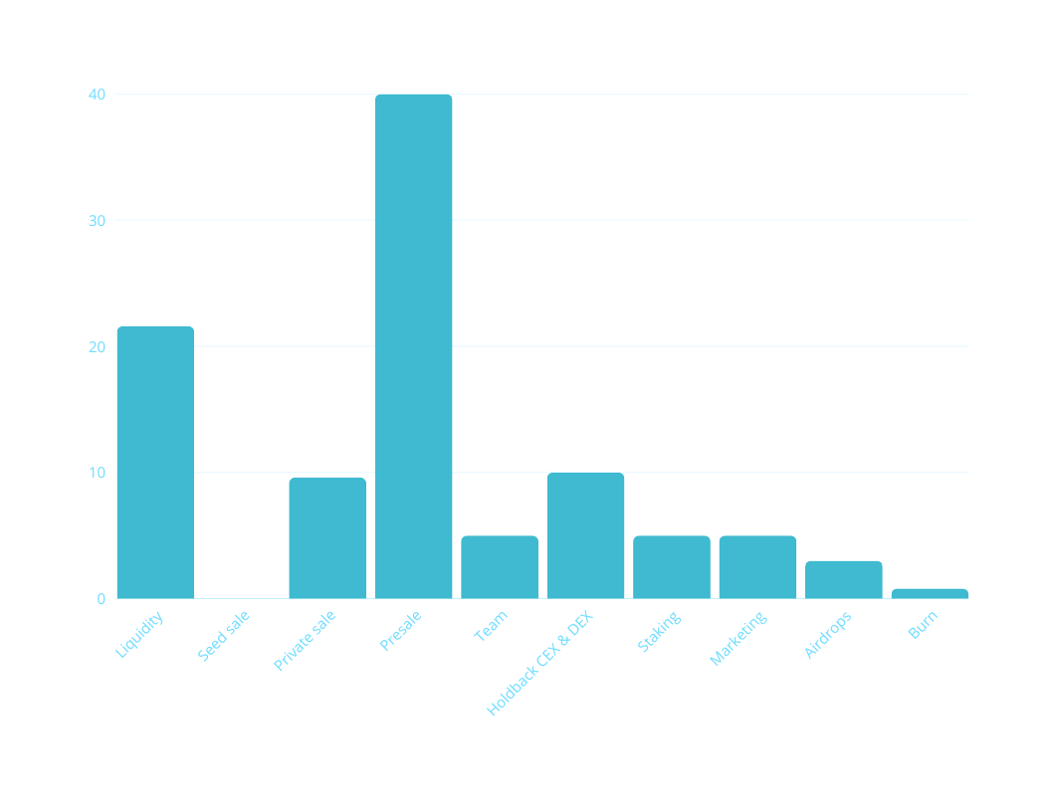
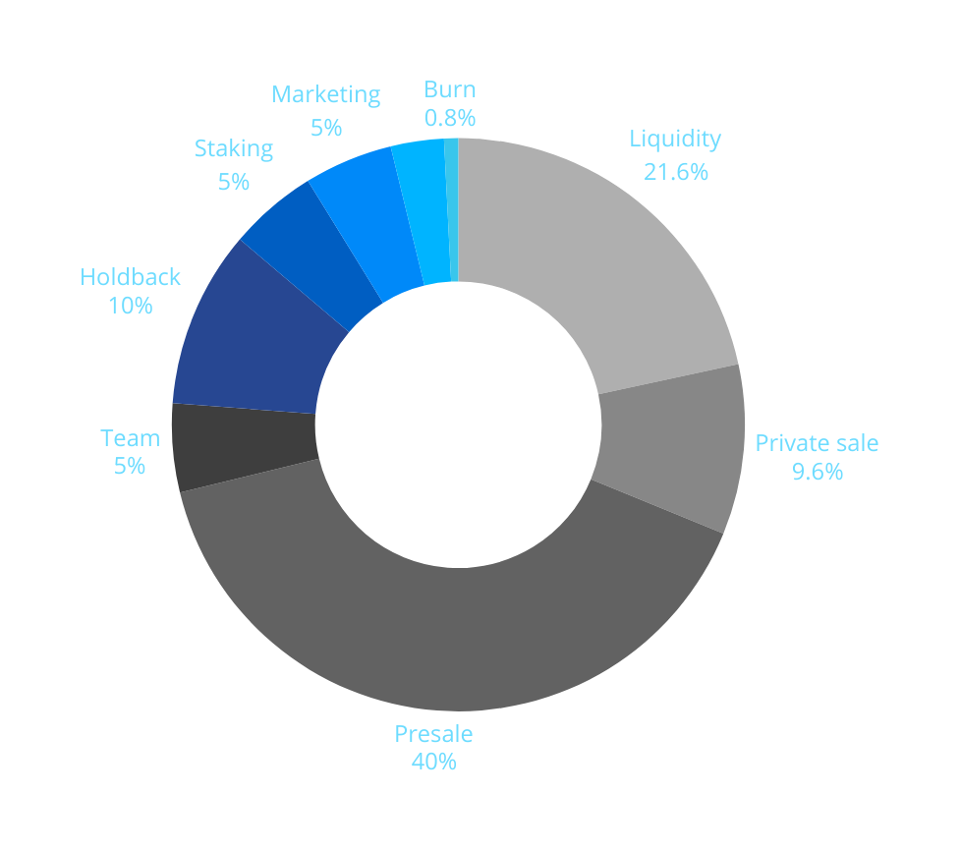
TOKENOMICS
8
Hemera Trading HEM token tokenomics vizualization

Slide 15
Imagine mastering the crypto market with precision and ease—Hemera Trading with AI makes it possible.

Slide 16
CONTACT US
9
https://t.me/hemeratrading
https://x.com/hemeratrading
https://discord.gg/SYM9KAEGjY
support@hemeratrading.net
https://hemeratrading.net

